Slide 1

PBCST504 – MICROCONTROLLERS
MICRO PROJECT
Zeroth Review

Slide 2
STM32 Smart Attendance Register Using RFID
Title:- STM32 Smart Attendance Register Using RFID
Group No:12
Members:JEC24CC014 ALBIN REJI
JEC24CC019 ANGEL ZENNA K WILSON
JEC24CC030 DEVAKKRISHNA K B
JEC24CC059 V GANESH KUMAR
JEC24CC061 VIJAY KRISHNA A S
Project Coordinator:
Ms.Sagna L T
Asst. Prof. CSE(CY)

Slide 3
STM32 Smart Attendance Register Using RFID
DEPARTMENT OF COMPUTER SCIENCE & ENGINEERING
(Cyber Security)
Vision of the Department
To be a globally recognized centre of excellence in Cyber Security education, research and innovation by nurturing ethical professionals , fostering technological advancement through responsible practice and contributing to a secure and sustainable digital society.

Slide 4
STM32 Smart Attendance Register Using RFID
DEPARTMENT OF COMPUTER SCIENCE & ENGINEERING
(Cyber Security)
Mission of the Department
M1: Excellence in Education : To provide outcome-based and industry-oriented education by integrating core computer science principles with advanced cybersecurity technologies and practices.
M2: Ethics and Professional Responsibility : To cultivate ethical values, integrity, social responsibility, and secure computing practices for protecting digital assets and strengthening cyber trust.
M3: Research, Innovation, and Entrepreneurship : To promote research, innovation, and entrepreneurial thinking for developing sustainable solutions to emerging cybersecurity challenges.
M4: Holistic and Global Development : To enhance leadership, teamwork, lifelong learning, and global competence through industry collaboration, interdisciplinary activities, and community engagement.

Slide 5
STM32 Smart Attendance Register Using RFID
Programme Educational Objectives (PEOs)
PEO 1: Graduates will apply strong foundations in computer science and cybersecurity to design, develop, and manage secure and reliable computing systems for industry and society.
PEO 2: Graduates will pursue successful careers as professionals, innovators or entrepreneurs engaged in technology development, deployment or engineering system implementation in industry and society and contribute to the economic growth of the country.
PEO 3: Graduates will demonstrate ethical responsibility, leadership, teamwork, and effective communication while adapting to evolving global technological environments through lifelong learning.

Slide 6
STM32 Smart Attendance Register Using RFID
Programme Outcomes
Engineering Graduates will be able to:
1. Engineering knowledge: Apply the knowledge of mathematics, science, engineering fundamentals, and an engineering specialization to the solution of complex engineering problems.
2. Problem analysis: Identify, formulate, review research literature, and analyze complex engineering problems reaching substantiated conclusions using first principles of mathematics, natural sciences, and engineering sciences.
3. Design/development of solutions: Design solutions for complex engineering problems and design system components or processes that meet the specified needs with appropriate consideration for the public health and safety, and the cultural, societal, and environmental considerations.
4. Conduct investigations of complex problems: Use research-based knowledge and research methods including design of experiments, analysis and interpretation of data, and synthesis of the information to provide valid conclusions.
5. Modern tool usage: Create, select, and apply appropriate techniques, resources, and modern engineering and IT tools including prediction and modeling to complex engineering activities with an understanding of the limitations.

Slide 7
STM32 Smart Attendance Register Using RFID
6. The engineer and society: Apply reasoning informed by the contextual knowledge to assess societal, health, safety, legal and cultural issues and the consequent responsibilities relevant to the professional engineering practice.
7. Environment and sustainability: Understand the impact of the professional engineering solutions in societal and environmental contexts, and demonstrate the knowledge of, and need for sustainable development.
8. Ethics: Apply ethical principles and commit to professional ethics and responsibilities and norms of the engineering practice.
9. Individual and team work: Function effectively as an individual, and as a member or leader in diverse teams, and in multidisciplinary settings.
10. Communication: Communicate effectively on complex engineering activities with the engineering community and with society at large, such as, being able to comprehend and write effective reports and design documentation, make effective presentations, and give and receive clear instructions.
11. Project management and finance: Demonstrate knowledge and understanding of the engineering and management principles and apply these to one’s own work, as a member and leader in a team, to manage projects and in multidisciplinary environments. 12. Life-long learning: Recognize the need for, and have the preparation and ability to engage in independent and life-long learning in the broadest context of technological change.

Slide 8
STM32 Smart Attendance Register Using RFID
Programme Specific Outcomes (PSOs)
On the completion of Computer Science & Engineering program, the students will possess:
PSO 1: Apply cyber security principles to mitigate cyber risk and analyze security requirements of an organization.
PSO 2: Develop and deploy secure software and infrastructure using modern tools and industry standards.
PSO 3: Uphold ethical, legal, and societal responsibilities while protecting privacy, data, and digital assets.

Slide 9
STM32 Smart Attendance Register Using RFID
CONTENTS
Motivation
Introduction
Problem Statement
Proposed Method
Basic Block Diagram
Conclusion
References

Slide 10
Motivation
STM32 Smart Attendance Register Using RFID
Manual attendance systems are time-consuming and prone to errors. Proxy attendance reduces the accuracy of attendance records. Institutions require a fast and paperless attendance system. Automation helps save time and improve efficiency

Slide 11
Introduction
STM32 Smart Attendance Register Using RFID
The project is an STM32-based Smart Attendance Register using RFID technology. It uses an RC522 RFID reader to scan RFID cards. The scanned card ID is compared with the stored database. Valid users have their attendance recorded automatically. The LCD displays the attendance status, and a buzzer alerts for invalid cards.

Slide 12
Problem Statement
STM32 Smart Attendance Register Using RFID
Manual attendance takes more time. Attendance records may contain human errors. Proxy attendance is difficult to detect. Existing systems require a more secure and automated solution

Slide 13
Proposed Method
STM32 Smart Attendance Register Using RFID
Initialize the STM32 microcontroller and RFID reader. Scan the RFID card and read its unique ID. Compare the card ID with the stored database. If the card is valid, record attendance and display “Attendance Marked” on the LCD. If the card is invalid, display “Access Denied” and activate the buzzer. Repeat the process for each user to ensure quick and accurate attendance.

Slide 14
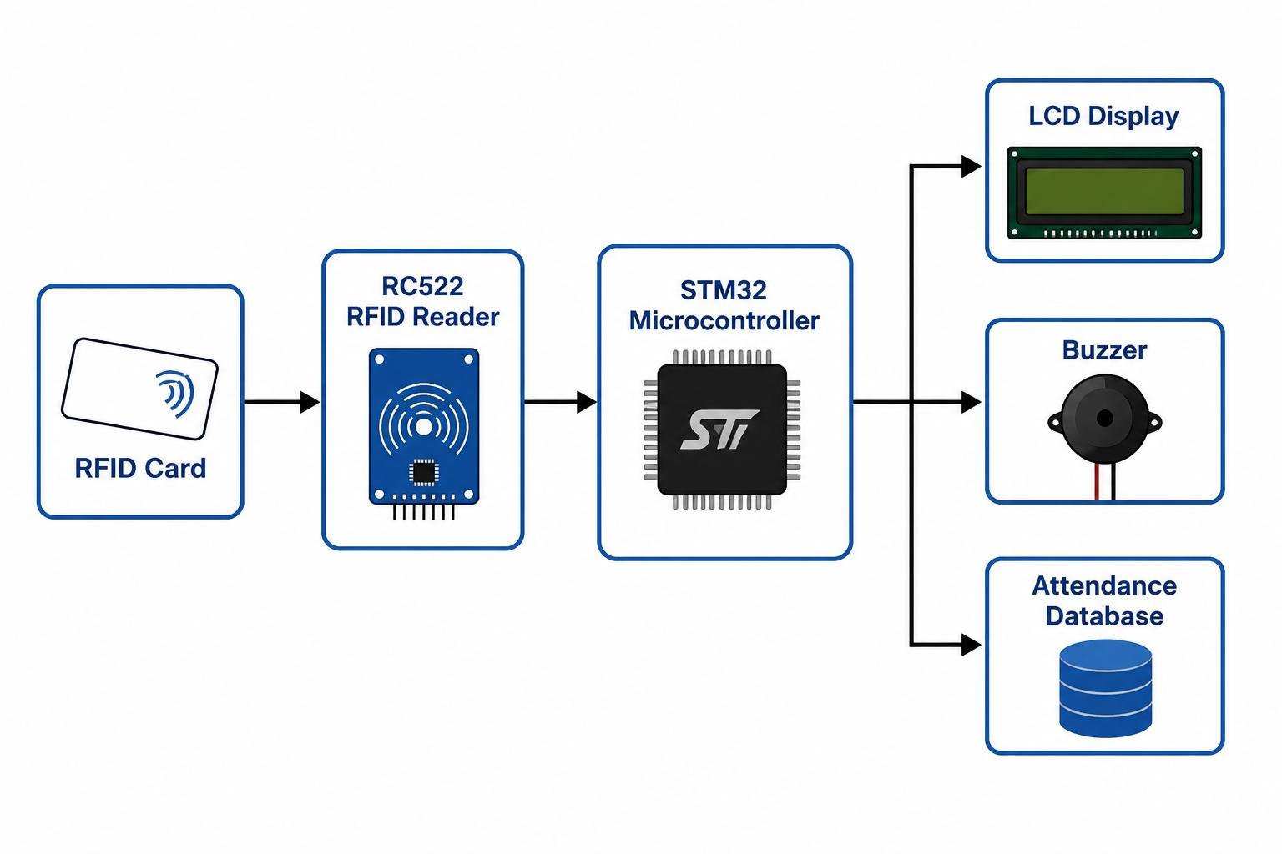
Basic Block Diagram
STM32 Smart Attendance Register Using RFID

Slide 15
Conclusion
STM32 Smart Attendance Register Using RFID
The system provides fast and accurate attendance recording. It minimizes human errors and prevents unauthorized access. The project offers a paperless and automated attendance solution. It is suitable for schools, colleges, and offices. �

Slide 16
References
STM32 Smart Attendance Register Using RFID
STM32 Microcontroller Datasheet. RC522 RFID Reader Module Datasheet. RFID Technology Documentation.

